Slide 1
TOP NEW TECHNOGIESIN AI
SlideMake.com

Slide 2
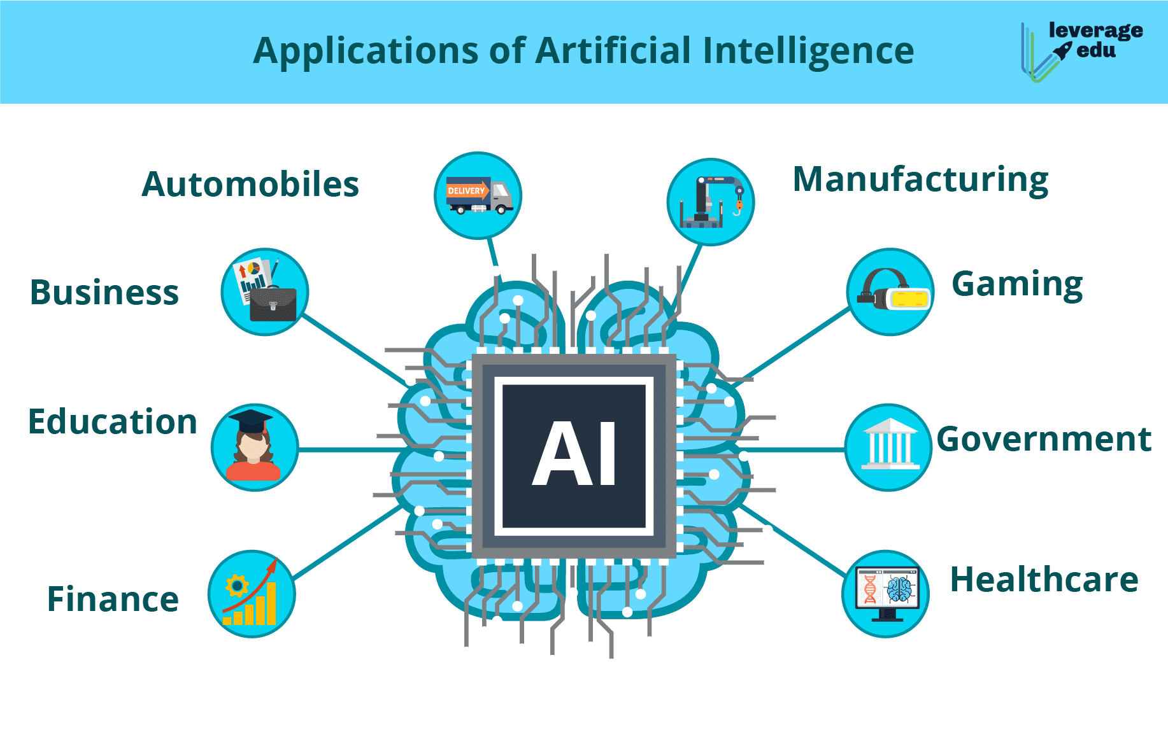
Introduction to Top New Technologies in AI
Artificial Intelligence (AI) is rapidly evolving, leading to the emergence of cutting-edge technologies.
These new technologies are revolutionizing various industries and transforming the way we live and work.
In this presentation, we will explore the top new technologies in AI that are shaping the future.
Notes:
Image source: http://gfca.in/artificial-intelligence/what-is-artificial-intelligence-introduction-types-history-features/

Slide 3
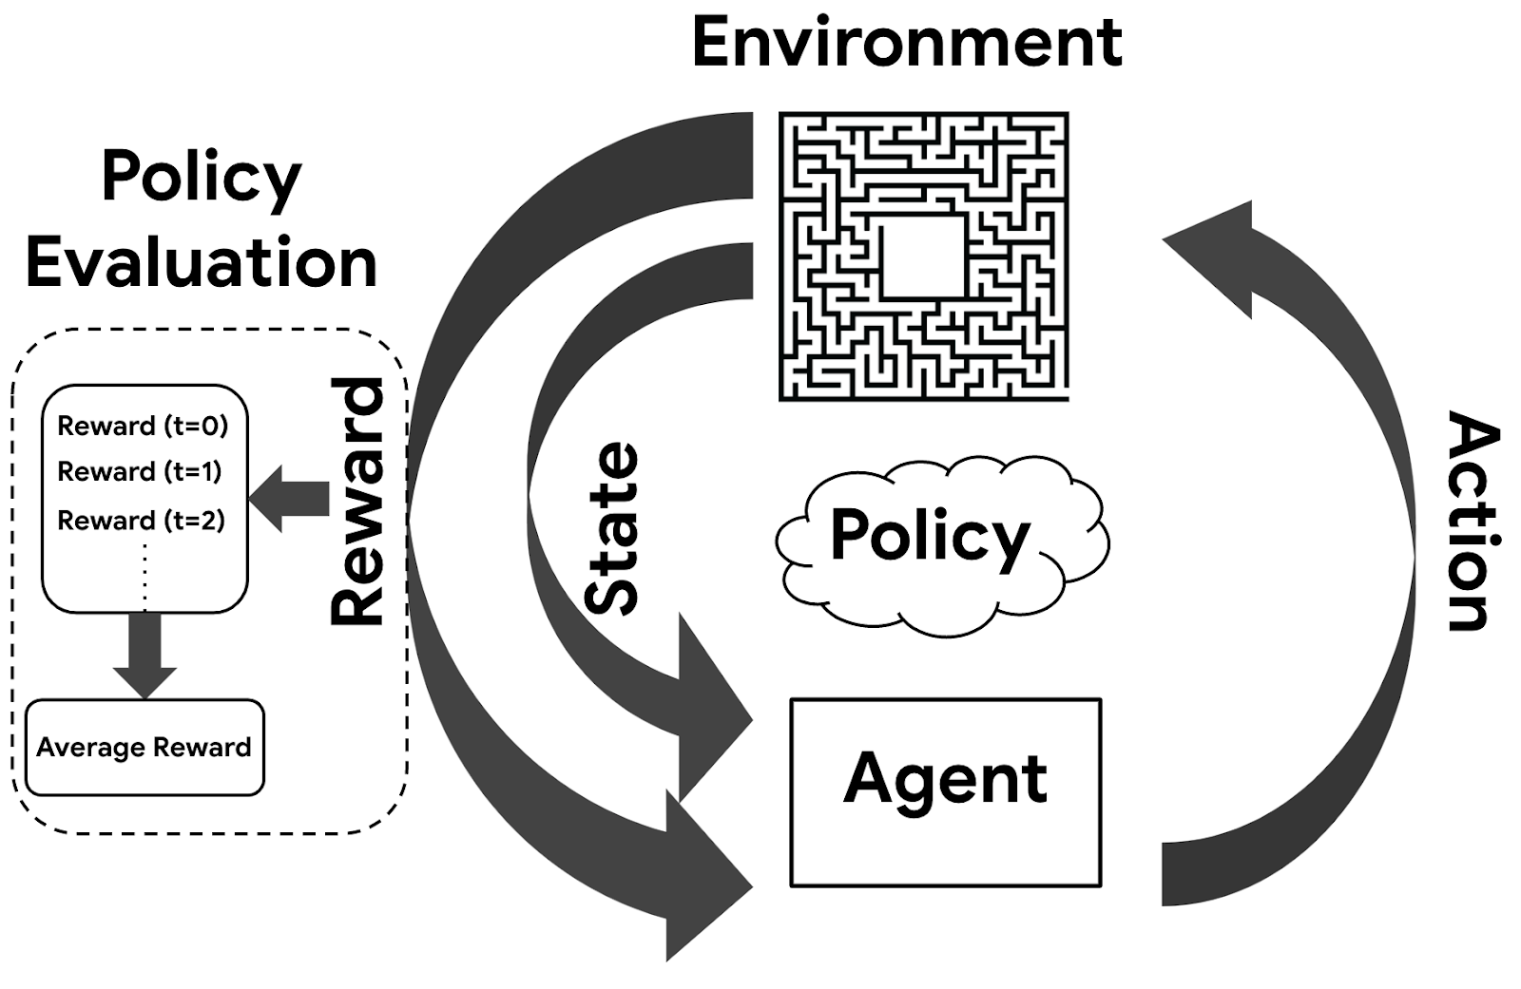
Reinforcement Learning
Reinforcement Learning is a machine learning technique where an agent learns to make decisions through trial and error.
This technology is being applied in autonomous vehicles, robotics, and game playing.
It enables AI systems to learn from experience and optimize their actions to achieve specific goals.
Notes:
Image source: https://techvidvan.com/tutorials/reinforcement-learning/

Slide 4
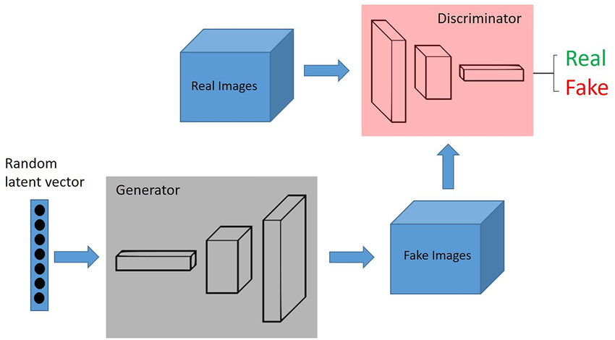
Generative Adversarial Networks (GANs)
GANs are a class of AI algorithms that generate new data samples similar to the training data.
This technology is used in creating realistic images, videos, and even text.
GANs have applications in art generation, image enhancement, and video manipulation.
Notes:
Image source: https://www.analyticsvidhya.com/blog/2021/10/an-end-to-end-introduction-to-generative-adversarial-networksgans/

Slide 5
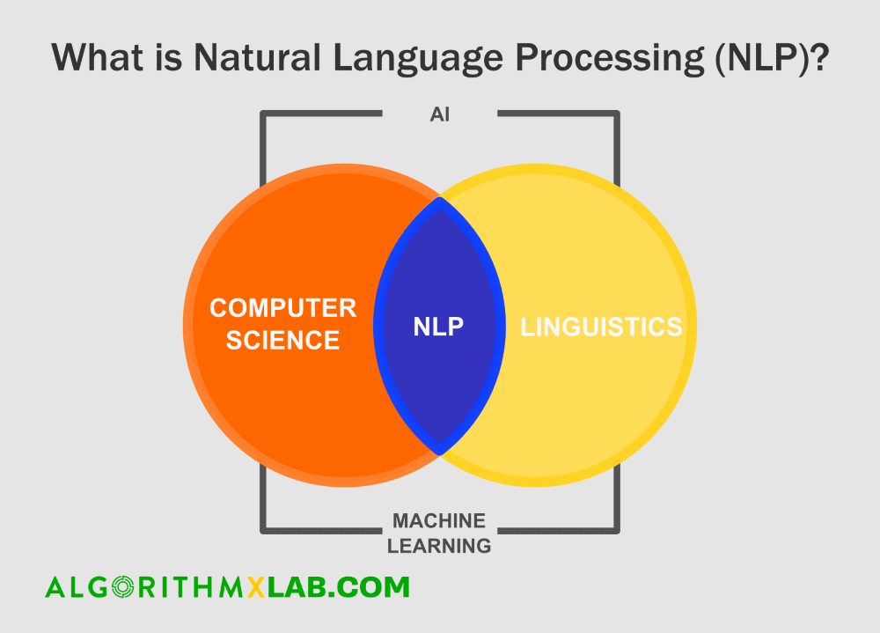
Natural Language Processing (NLP)
NLP is a branch of AI that focuses on the interaction between computers and humans using natural language.
This technology powers virtual assistants like Siri, Alexa, and Google Assistant.
NLP is advancing with the development of language models like BERT and GPT-3.
Notes:
Image source: https://kili-technology.com/data-labeling/nlp/natural-language-processing-machine-learning

Slide 6
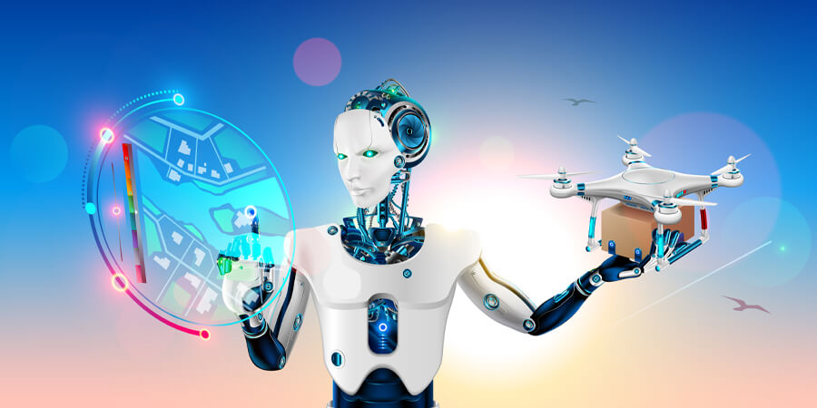
Autonomous Machines
Autonomous machines are AI-powered devices that can perform tasks without human intervention.
These machines include drones, self-driving cars, and industrial robots.
The integration of AI enables these machines to make decisions in real-time based on sensor inputs.
Notes:
Image source: https://am.is.mpg.de/research_projects/autonomous-robotic-manipulation

Slide 7
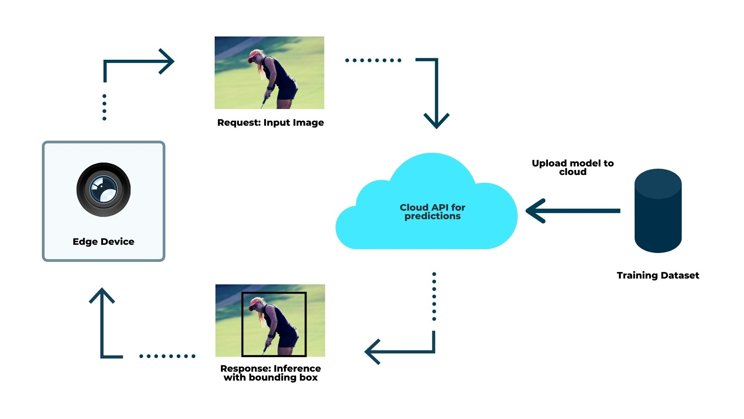
Edge AI
Edge AI refers to the deployment of AI algorithms on local devices or edge devices rather than in the cloud.
This technology enables faster processing and reduces latency for AI applications.
Edge AI is vital for IoT devices, autonomous vehicles, and industrial automation.
Notes:
Image source: https://www.xenonstack.com/blog/edge-ai-use-case

Slide 8
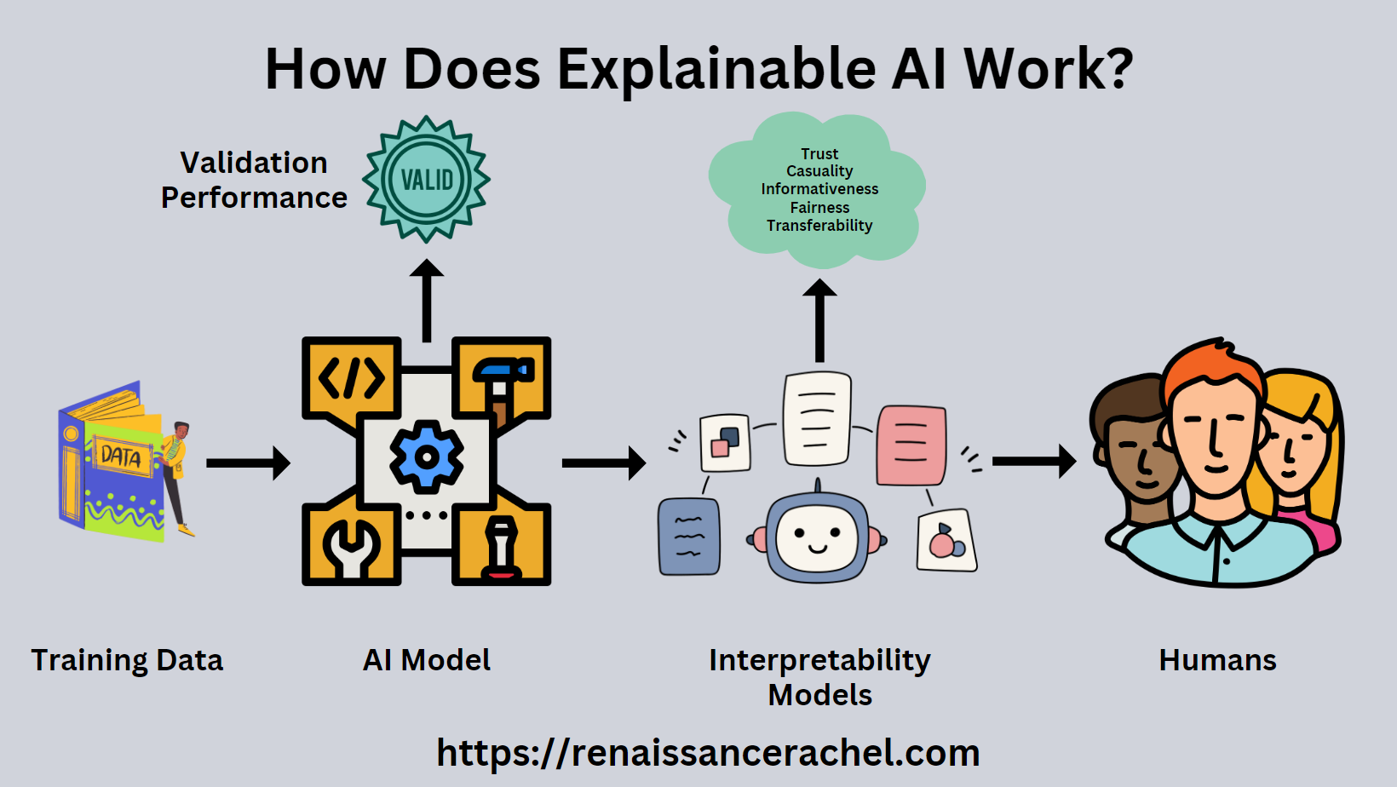
Explainable AI
Explainable AI focuses on developing AI systems that can explain their decisions and actions in a human-understandable manner.
This technology is crucial for building trust in AI systems and ensuring transparency.
Explainable AI is essential for applications in healthcare, finance, and legal sectors.
Notes:
Image source: https://datascirnceexplainableai.blogspot.com/2022/06/explainable-ai.html

Slide 9
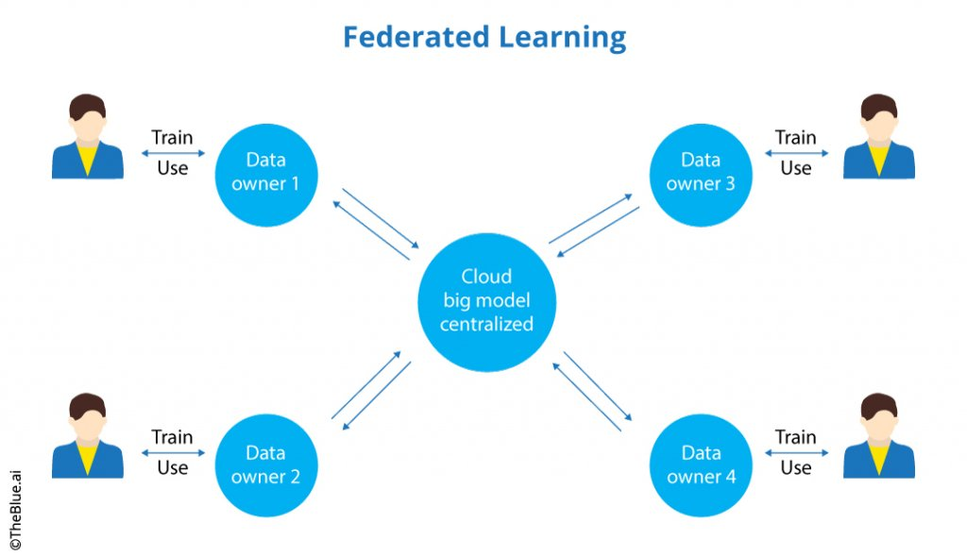
Federated Learning
Federated Learning is a decentralized machine learning approach where multiple devices collaboratively train a global model while keeping data local.
This technology preserves data privacy and reduces the need for data centralization.
Federated Learning is used in applications like personalized recommendations and predictive maintenance.
Notes:
Image source: https://theblue.ai/blog/federated-learning/

Slide 10
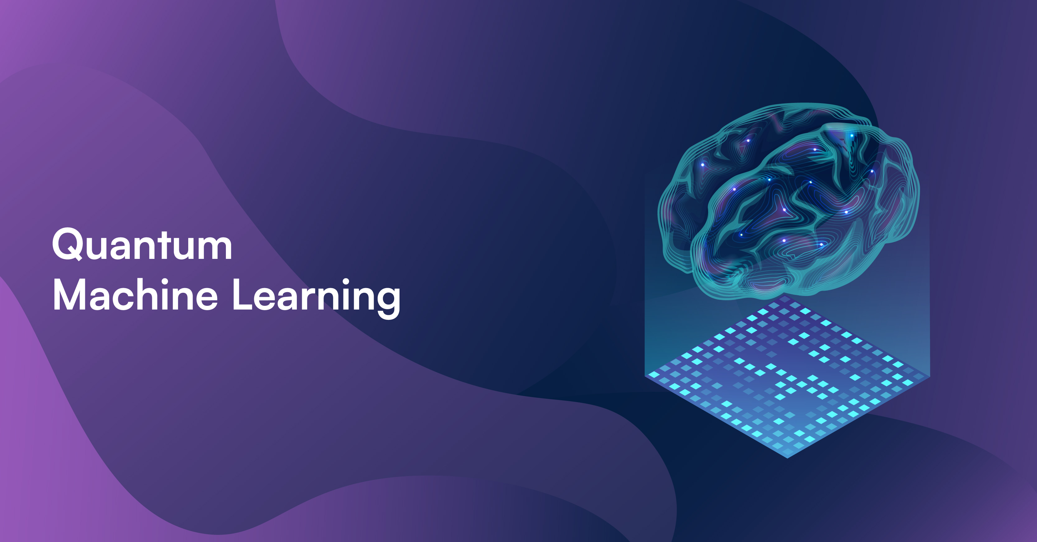
Quantum Machine Learning
Quantum Machine Learning combines quantum computing and machine learning to solve complex problems.
This technology has the potential to exponentially speed up AI computations.
Quantum Machine Learning is still in its early stages but holds great promise for the future of AI.
Notes:
Image source: https://www.bluequbit.io/quantum-machine-learning

Slide 11
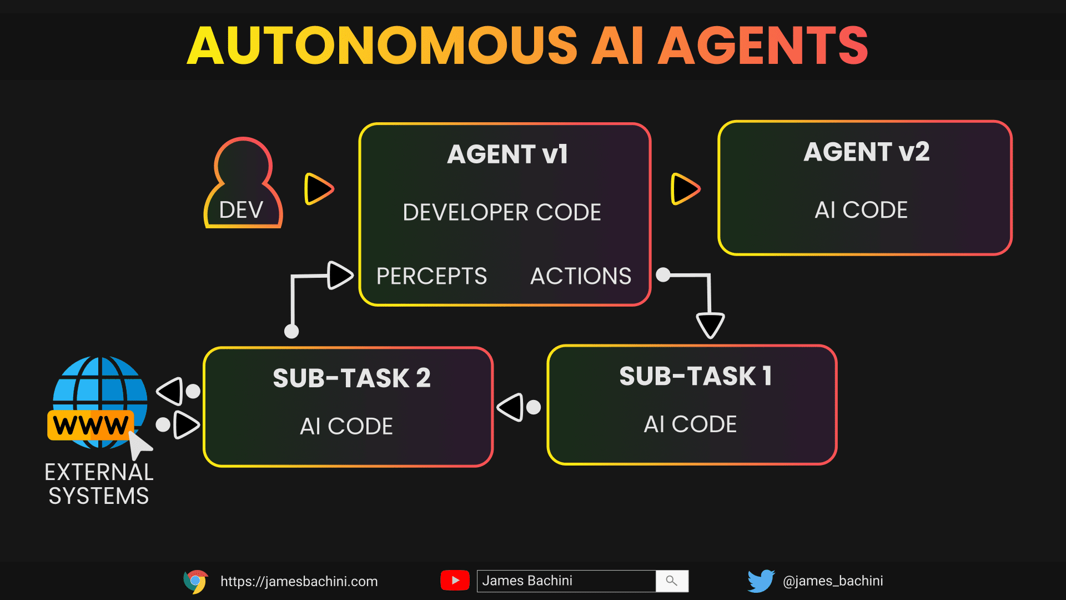
Autonomous Agents
Autonomous agents are AI systems that can independently perform tasks and make decisions based on their environment.
These agents are used in gaming, virtual assistants, and autonomous vehicles.
The development of autonomous agents is advancing with reinforcement learning and deep learning techniques.
Notes:
Image source: https://jamesbachini.com/autonomous-ai-agents/

Slide 12

Computer Vision
Computer Vision is a field of AI that enables machines to interpret and understand visual information.
This technology is used in facial recognition, object detection, and medical image analysis.
Computer Vision is advancing with the development of convolutional neural networks and image processing techniques.
Notes:
Image source: https://www.techallabout.com/computer-vision/

Slide 13
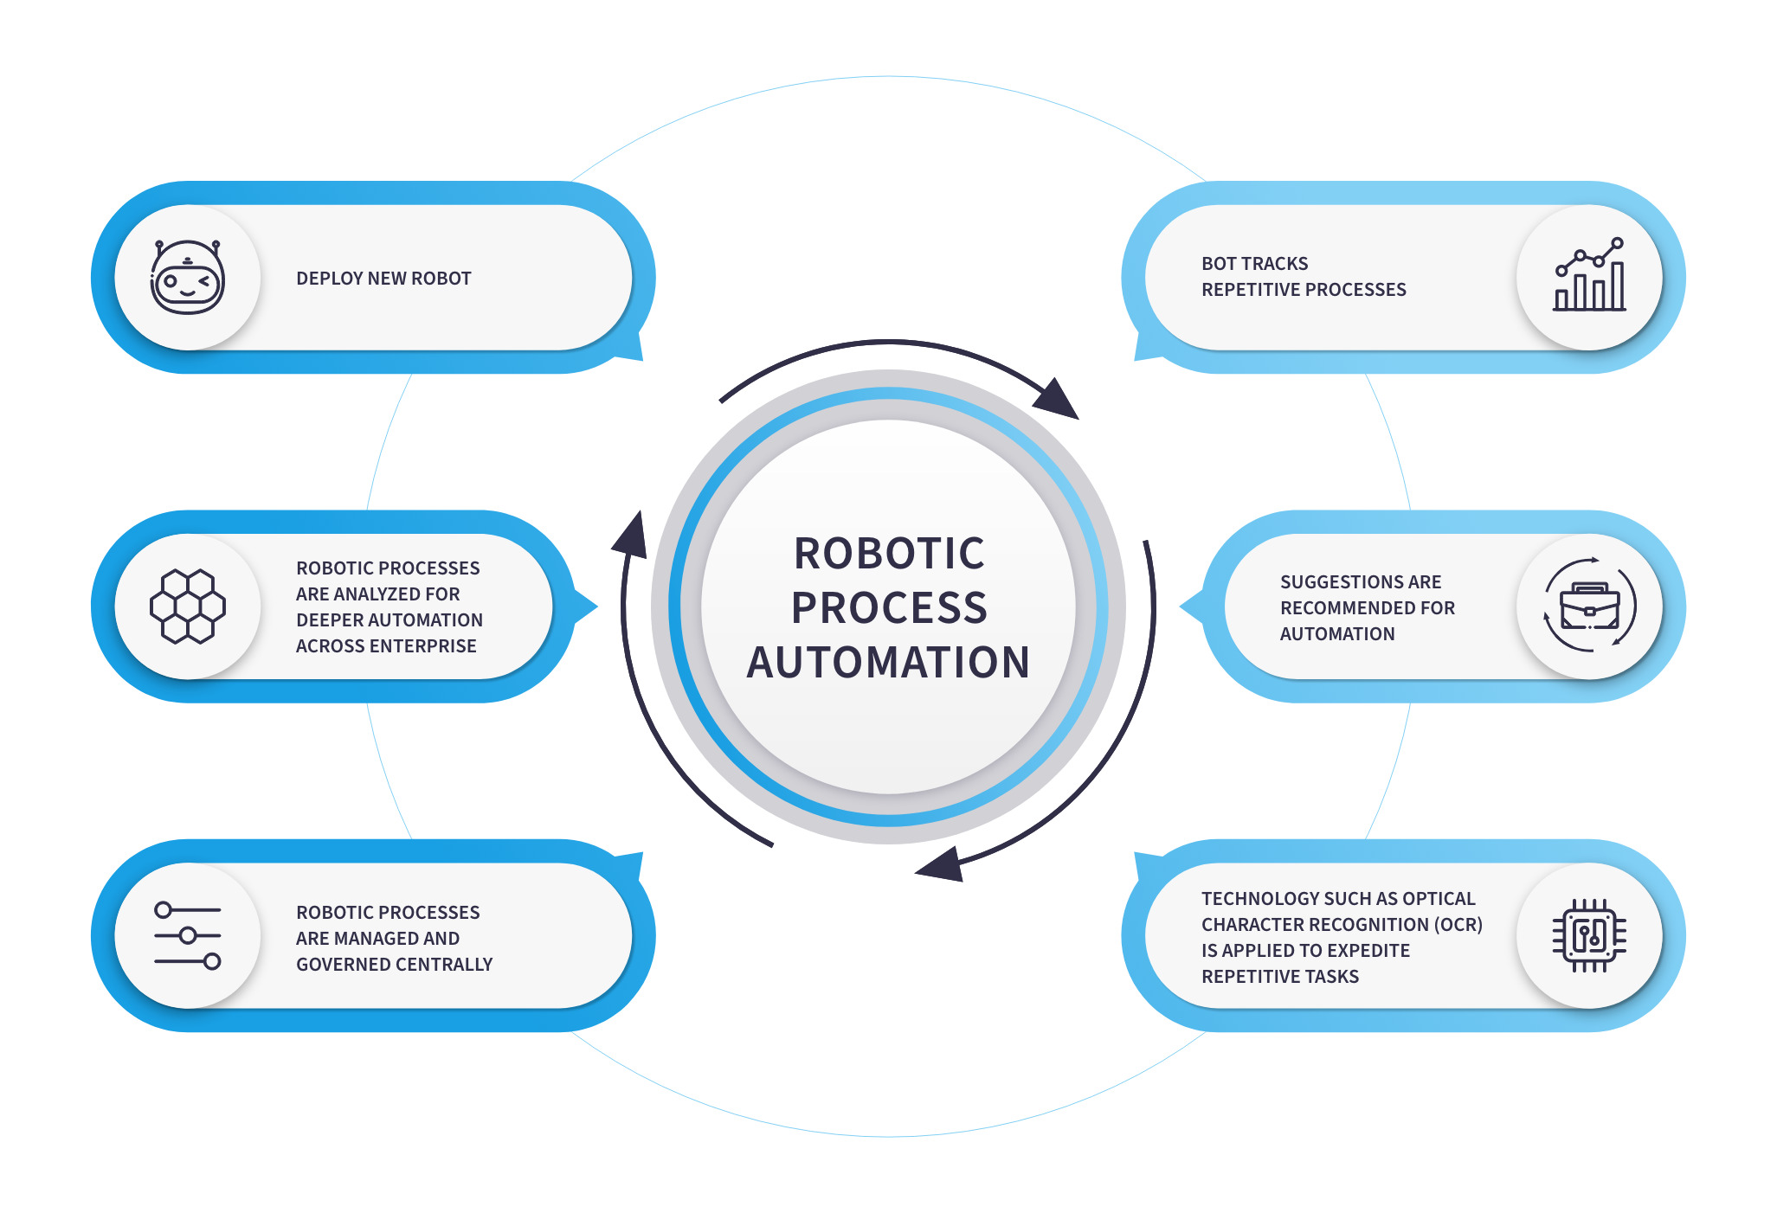
Robotics Process Automation (RPA)
RPA involves the use of software robots or AI workers to automate repetitive tasks in business processes.
This technology improves efficiency, reduces errors, and enhances productivity.
RPA is transforming industries like finance, healthcare, and manufacturing.
Notes:
Image source: https://nix-united.com/blog/what-is-rpa-and-how-can-businesses-use-it-for-their-benefit/

Slide 14
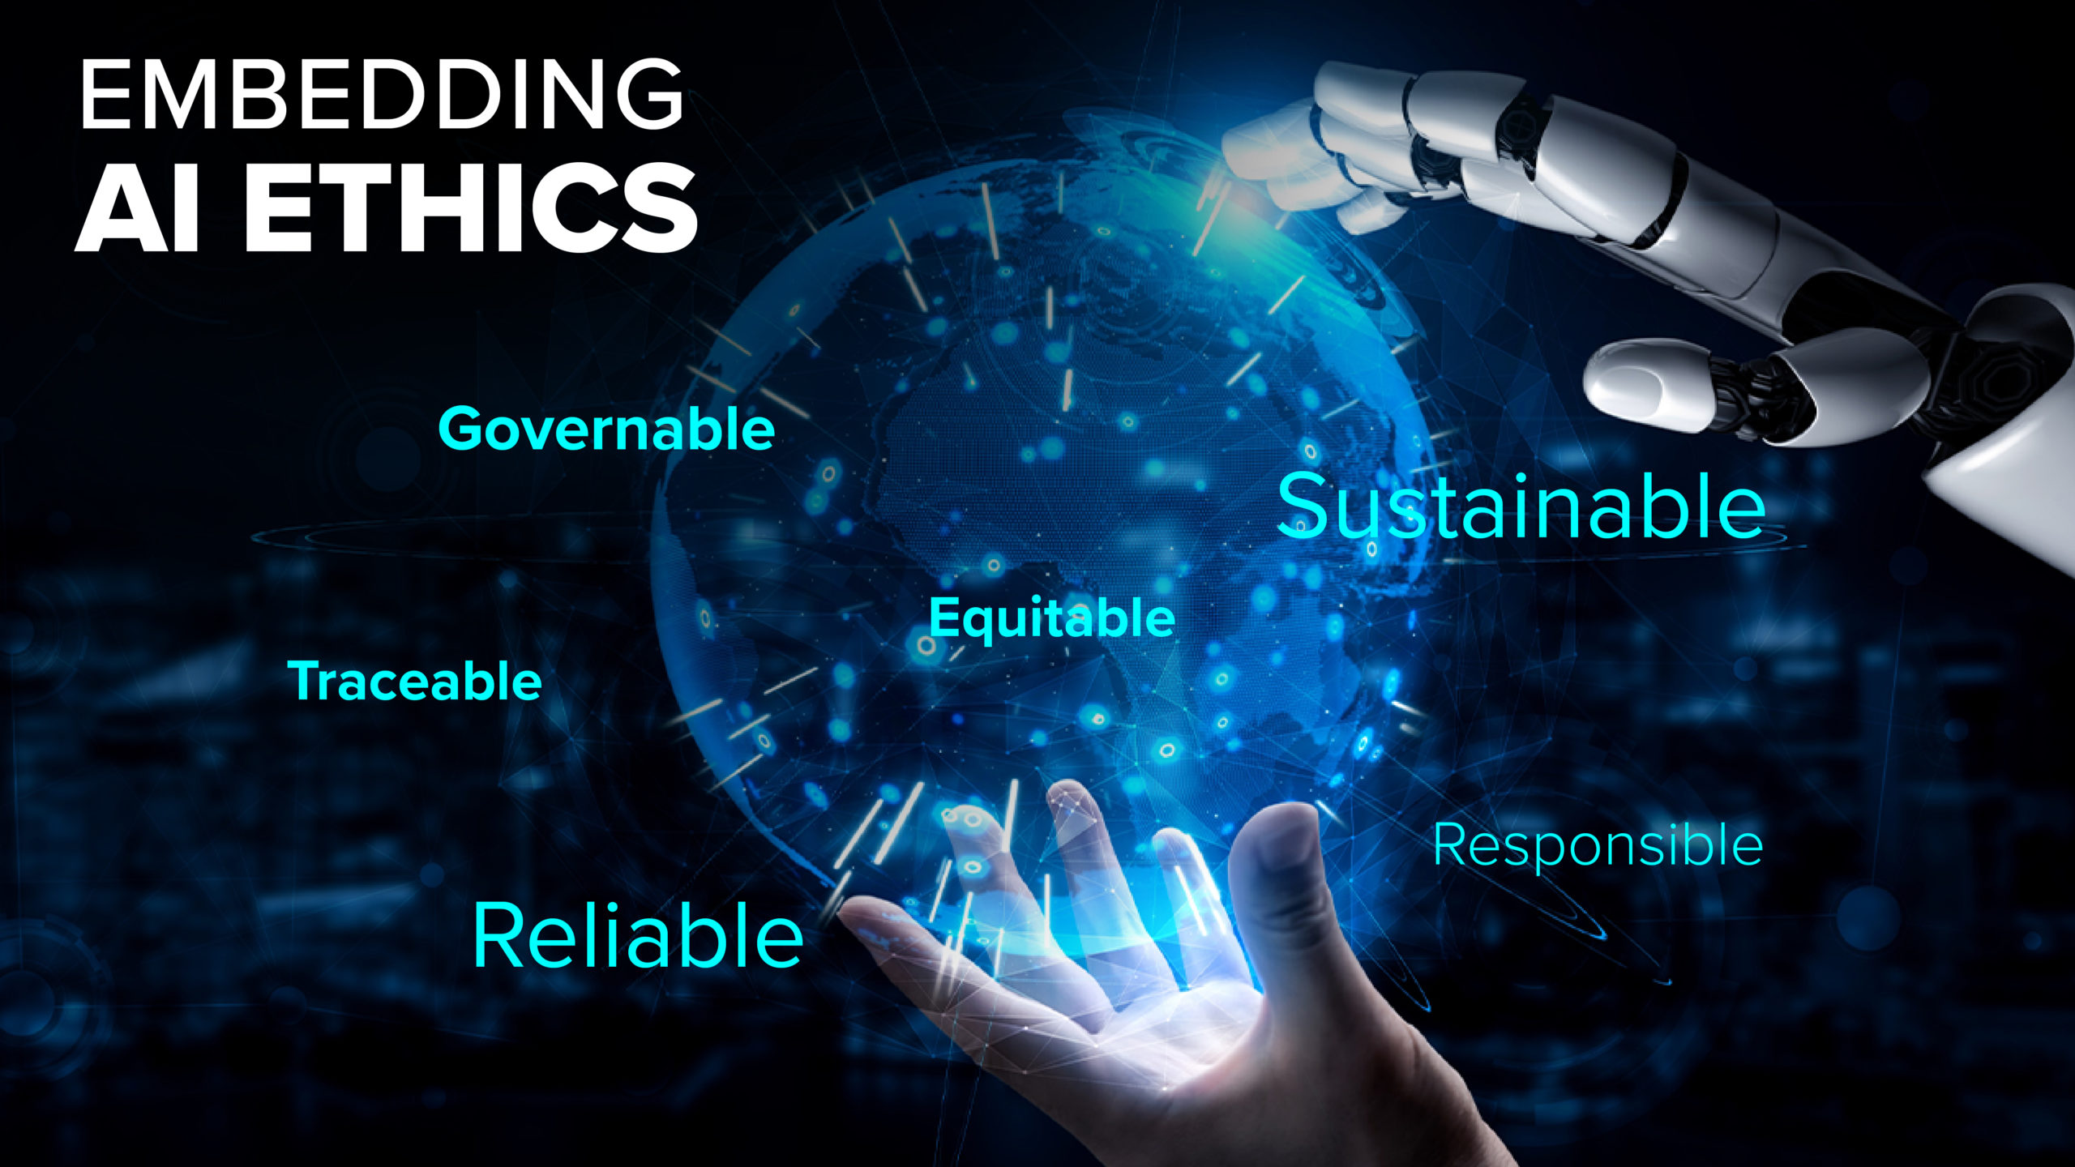
AI Ethics and Bias Mitigation
AI Ethics focuses on ensuring that AI systems are developed and used in a responsible and ethical manner.
Bias mitigation techniques aim to reduce bias in AI algorithms and decision-making processes.
Addressing AI ethics and bias is critical for building fair and trustworthy AI systems.
Notes:
Image source: https://cra.com/embedding-ai-ethics-making-ai-safer-for-humanity/

Slide 15
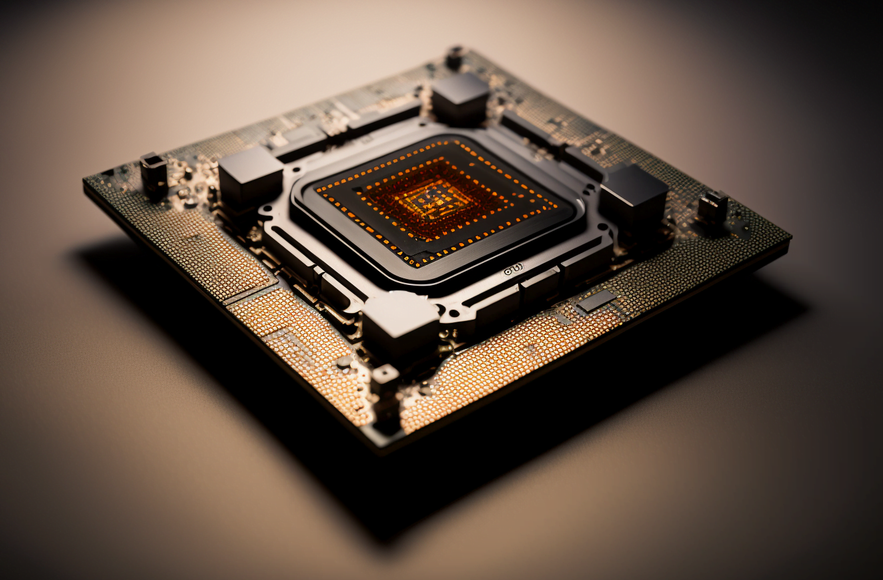
AI Chipsets and Hardware Accelerators
AI Chipsets and Hardware Accelerators are specialized hardware components designed to optimize AI computations.
These technologies enable faster training and inference tasks for AI models.
AI Chipsets and Hardware Accelerators are essential for deploying AI at scale in various applications.
Notes:
Image source: https://the-decoder.com/what-is-ai-hardware-approaches-advantages-and-examples/

Slide 16
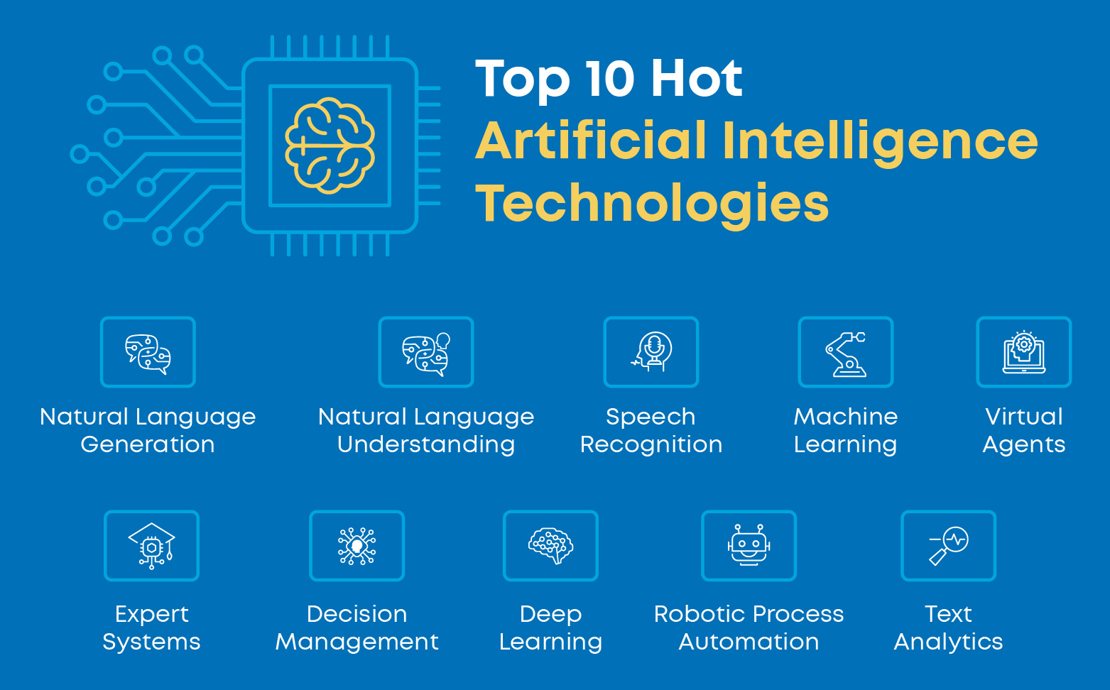
Conclusion and Future Outlook
The top new technologies in AI are driving innovation and reshaping industries across the globe.
As AI continues to advance, we can expect more breakthroughs in areas like healthcare, finance, and sustainability.
Embracing these technologies responsibly will be key to unlocking the full potential of AI for the benefit of society.
Notes:
Image source: https://myaiplug.com/10-hottest-artificial-intelligence-ai-technologies-in-2024/

Slide 17
Thank You

